Slide 1
Z-Rays: Divide Arrays and Conquer Speed and Flexibility
Jennifer B. Sartor
jbsartor@cs.utexas.edu
Stephen M. Blackburn, Daniel Frampton, Martin Hirzel, Kathryn S. McKinley

Slide 2
Arrays
[Zuse 46]
IBM WebSphere, AICAS Jamaica VM, Fiji VM
>50%
Time/space tradeoff
Notes:
Contiguous arrays are ubiquitous, they organize indexed data. Invented by Zuse in 1946 before programming languages. Take up > 50% of the heap.
I will talk about how to break up arrays (bridge gap) with both time and space efficiency. These production JVMs break up arrays.
Time/space tradeoff – which managed languages can address.

Slide 3
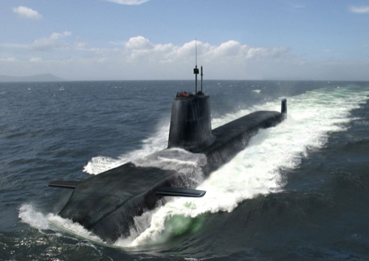
Why Discontiguous?
Real-time
Problem: large arrays
Collection: space & time unbounded for scan/copy
Fragmentation
[Siebert 00, Bacon et al. 03/05, Chen et al. 03]
Sacrifice throughput for predictability
Notes:
Safety-critical, real-time applications, defense system, financial market.

Slide 4
Z-Rays
Flexible, memory and time efficient
Spine of indirection pointers to arraylets
Space optimizations
Lazy allocation
Zero compression
Novel arraylet copy-on-write
Time optimizations
Inline first-N bytes into spine
Fast array copy
12.7%
*Most effective
Prior work optimizations: 27-32%
Notes:
average overhead, worst: 76-107%. Our worst: 57%

Slide 5
Naïve Discontiguous Arrays
Array
Header | Arraylet Pointers | Remaining Elements
Remove expensive indirection?
Uniform access
Arraylet
Arraylet
Arraylet
Arraylet

Slide 6
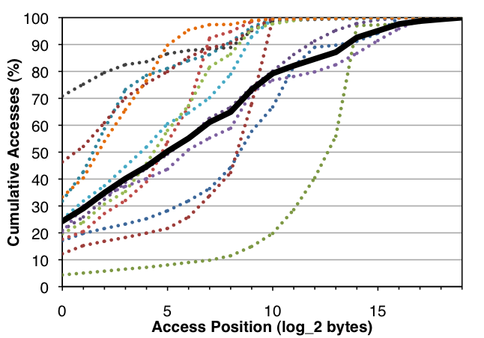
Access Statistics
mean
>85% accesses to first 4KB

Slide 7
Optimized Discontiguous Arrays
*Fast
Slow access
Array
Spine
Header | Inlined FirstN | Arraylet Pointers | Remaining Elements
Arraylet Space
Arraylet | Arraylet | Arraylet | ... | Arraylet
Notes:
Can tune first-N and arraylet size based on time/space tradeoff

Slide 8
Flexible Arraylets
Memory management
Spine in generational spaces
Spine defines array “age” for timely reclamation [Hosking et al. 92]
Arraylets non-moving
Space optimizations [inspired by Chen et al. 03]
Lazy allocation
Zero compression
Array copy optimizations
Time: fast array copy
Space: arraylet sharing with copy-on-write

Slide 9
Lazy Allocation & Zero Compression
Array
Spine
Header | Inlined FirstN | Arraylet Pointers | Remaining Elements
Zero compress
Lazy allocate
Zero Arraylet
Arraylet Space
Arraylet | Arraylet | Arraylet | ... | Arraylet

Slide 10
Copy & Share Arraylets
Src
Hdr | 1stN | Ptrs | Remain
Dest
Hdr | 1stN | Ptrs | Remain
Arraylet copy-on-write
Fast array copy
arraylet write
Arraylet Space
Arraylet | Arraylet | Arraylet | ... | Arraylet

Slide 11
Methodology
Jikes Research Virtual Machine 3.0.1
Results are % overhead above contiguous
Adaptive compilation: 10th iteration, 20 JVM invocations
GenMarkSweep, 2x min heap
19 benchmarks: DaCapo, pseudojbb2005, SPECjvm98
Core 2 Duo with 2 processors

Slide 12
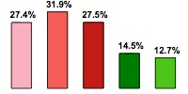
Overall Result
Configuration Parameter/ Optimization | Naïve | NaïveA (Chen) | NaïveB (Bacon) | Z-ray | Perf Z-ray
Arraylet Bytes | 2¹⁰ | 2¹⁰ | 2¹¹ | 2¹⁰ | 2¹⁰
First-N |  |  |  | 2¹² | 2¹²
Lazy Alloc |  | ✔ |  | ✔ | ✔
Zero Compress |  |  |  | ✔ | ✔
Array Copy |  |  |  | ✔ | ✔
Copy-on-write |  |  |  | ✔
31.9
27.4
27.5
% Time
Overhead
14.5
12.7
Notes:
Make space/time tradeoff clear – esp with COW

Slide 13
Time Optimizations
Benchmark accesses, firstN=2¹² bytes
Fast <= firstN; slow > firstN
91% of array accesses are to fast path
Removing first-N from Z-ray adds 10%
No fast array copy adds 2.8%
 | Fast Write% | Slow Write% | Fast Read% | Slow Read%
min | 0.7 | 0.1 | 25.3 | 0.1
max | 28.6 | 22.5 | 98.1 | 39.3
mean | 6.4 | 2.6 | 84.6 | 6.4
Notes:
Space/time tradeoff again here. Circles are benchmarks that won’t benefit from first-N optimization much

Slide 14
Space Optimizations
Lazy allocation most effective
Xalan saves 56% of collection time, 5.5% total time
All: lazy allocation, zero compression, copy-on-write
Best: xalan 25%, compress 49% of heap
Average: save 6% of heap

Slide 15
Z-Ray Takeaways
Flexible, time and space efficient discontiguous arrays
Tunable optimization options
Reduce previous overhead by 2-3x
Save 6% of heap space
More efficient for real-time
Feasible for future chip multiprocessors
Notes:
Thank you!

