Slide 1
Profiling Individuals from speech & text

Slide 2
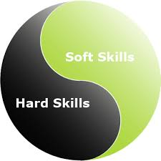


Project summary
Profiling Individuals from speech & written texts
soft skills
hard skills
emotional/mental state
Domains
human resources (job matching, EVC, …)
customer care (contact center, eHealth, …)

Slide 3
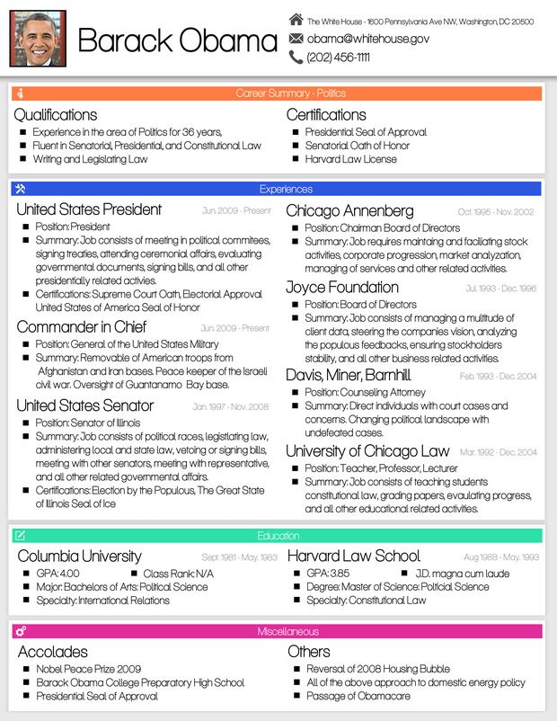
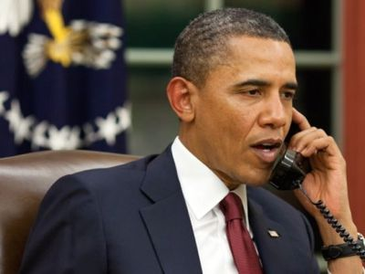
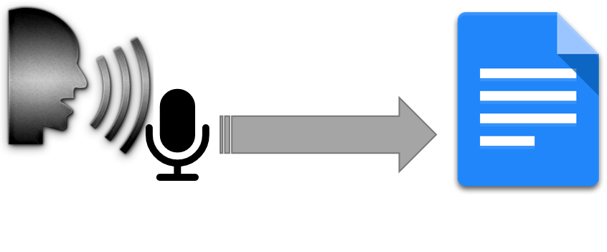
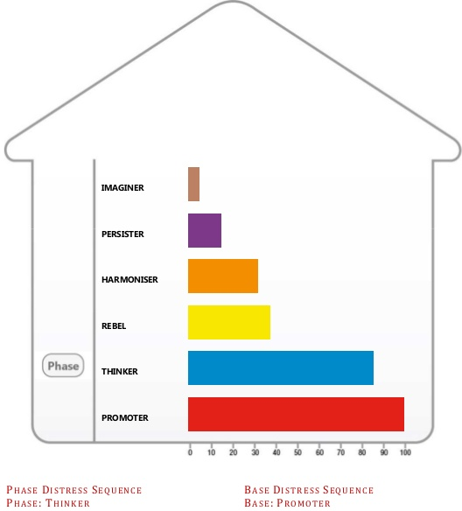
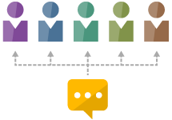

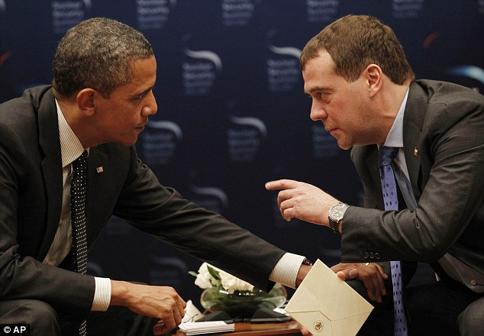
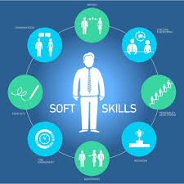
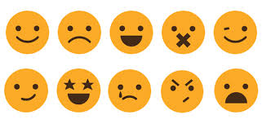
written communication
telephone conversations
speech recognition
text
speaker identification
PCM
topic identification
speech
emotion/stress/mental state
face-to-face conversations
contact center info
soft skills
skills

Slide 4
Process Communication Model (PCM)
Result of Dr. T. Kahler’s research (1970’s) in partnership with NASA
Introduced in the US in 1982, in Europe in 1987 (by Gérard Collignon)
Tool that helps in:
  optimise relationship management
  development of self-knowledge
  knowledge of others
Describes personality as a unique combination
of 6 personality types
Personality types are connected with
  behavioural traits
  preferential modes of interpreting reality
  motivations
  ways of communicating
  predictable, observable behaviour under stress

Slide 5

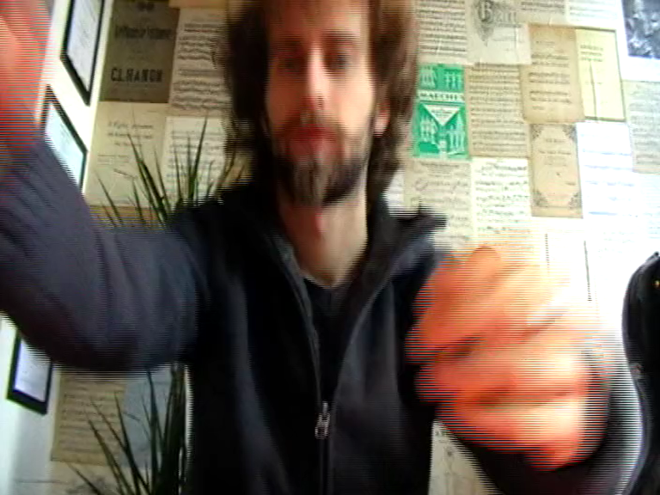
Process Communication Model (PCM)
Belgium (FL) trainers:
Edwin Hantson & M. Claire Van de Velde (2x UGent)
Process Communication Model is practical:
  connected with observations (not solely based on questionnaire)
  MatterSight and other companies are based on PCM
  tools for successful everyday management
Used in/for:
  management
  sales relations
    better customer experience
    less stress with sales persons
  recruitment aid
  improve cooperation
    team building / individual or team coaching
    conflict management
    internal trainers (transmitting competencies)

Slide 6
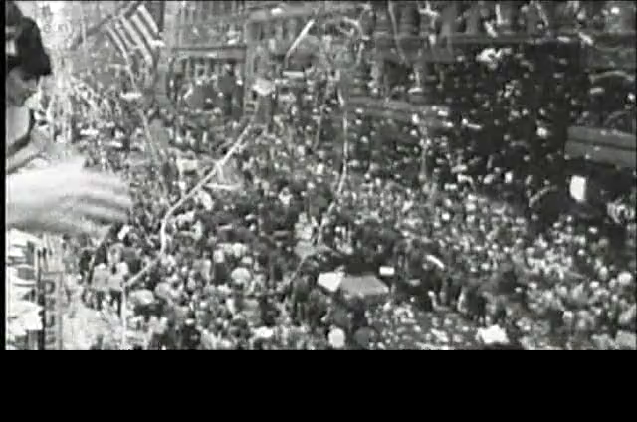

speech processing
Speech recognition
  convert speech into text
  challenges:
    spontaneous speech
    dialects
Speaker identification
Speaker diarization
  who speaks when
  language/dialect spoken
Other non-verbal information
  emotion (e.g. stress) can be heard in a voice
    happy
    sad
  useful as extra information in may tasks

