Slide 1
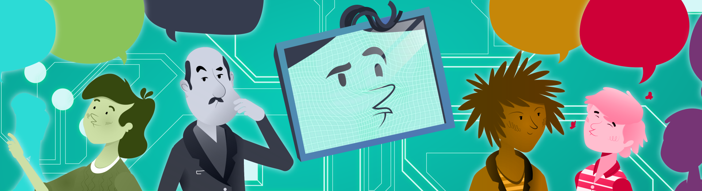



2nd CEF eTranslation Conference
Text-to-speech & Speech recognition
Kris Demunyck

Slide 2
2nd CEF eTranslation Conference
Text-to-speech & Speech recognition
(technology for speech to speech translation)
Topics
Intelligence: human intelligence vs artificial intelligence
How do computers cope with spoken and written language
Challenges in speech → text, text → speech and text → text

Slide 3







language/speech = intelligence?
no
yes
conveying complex thoughts; the use of abstract symbols
rechtop lopen?
Notes:
What still remains: language (abstract symbols, being creative, …)

Slide 4
Taal is de sleutel tot echte artificiële intelligentie
Language is the key to true artificial intelligence (strong AI)
(Walter Daelemans, De Tijd, Sept 18, 2018)

Slide 5
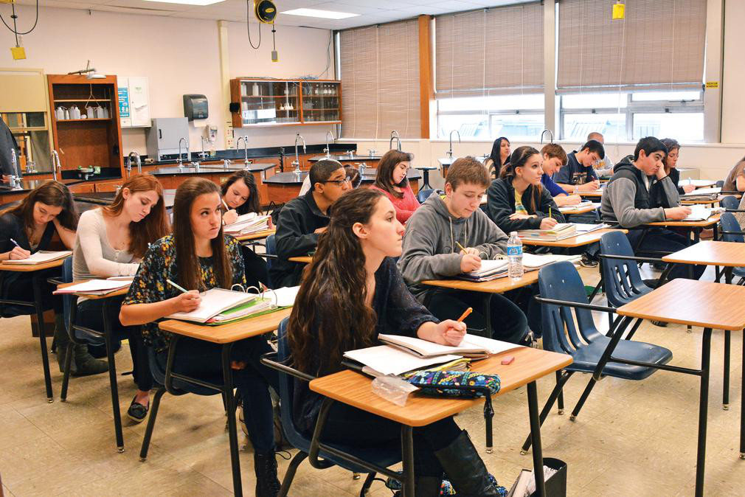
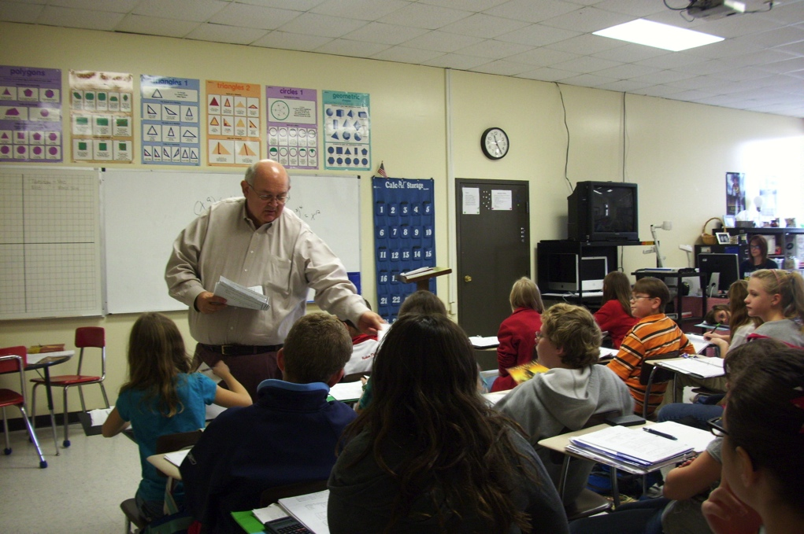

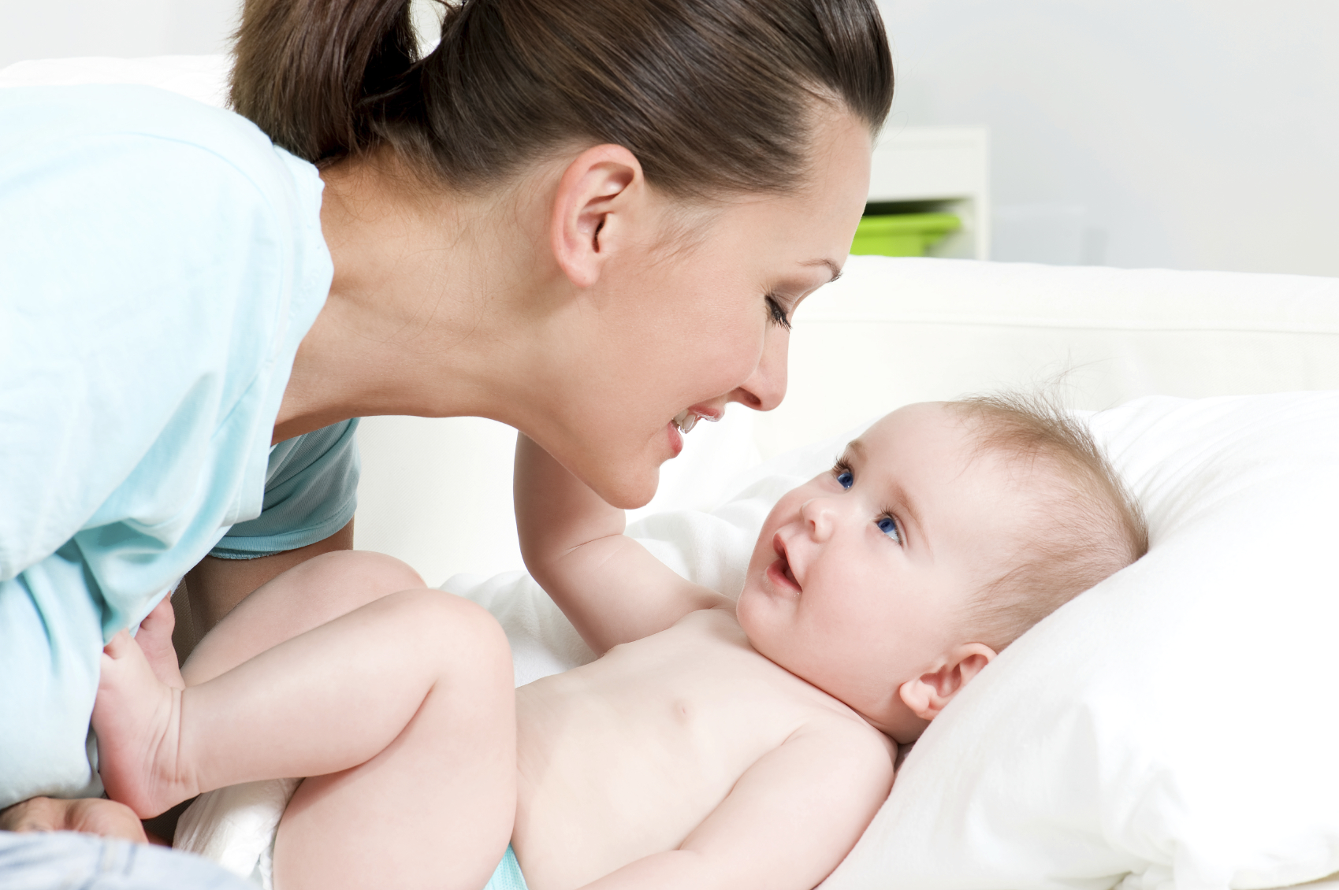
Speech & language by humans …
Seems easy … but we tend to forget it took years of daily practice to master this.
6 years of secondary school: extend vocabulary, world knowledge, other languages
6 year primary school:
mastering complex sentences
3 years kinder garden: short sentences
start: passive listening

Slide 6
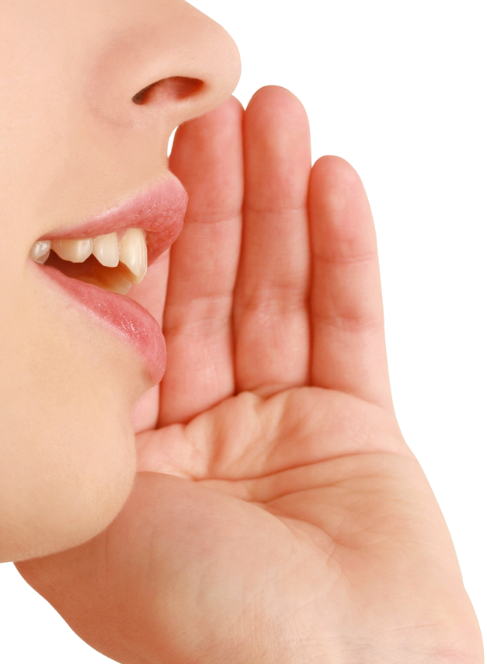
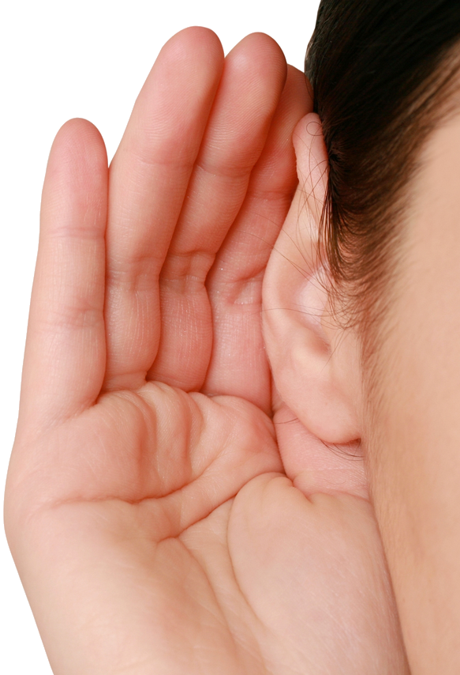
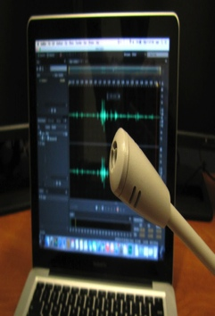

Speech is difficult: an analogy
humans
similar to handwriting recognition
computers

Slide 7
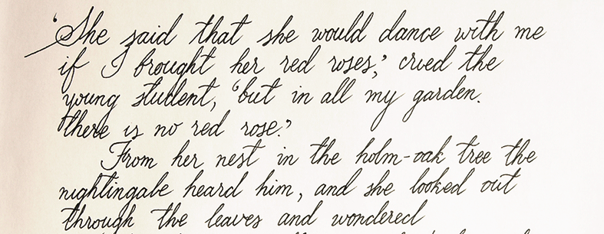
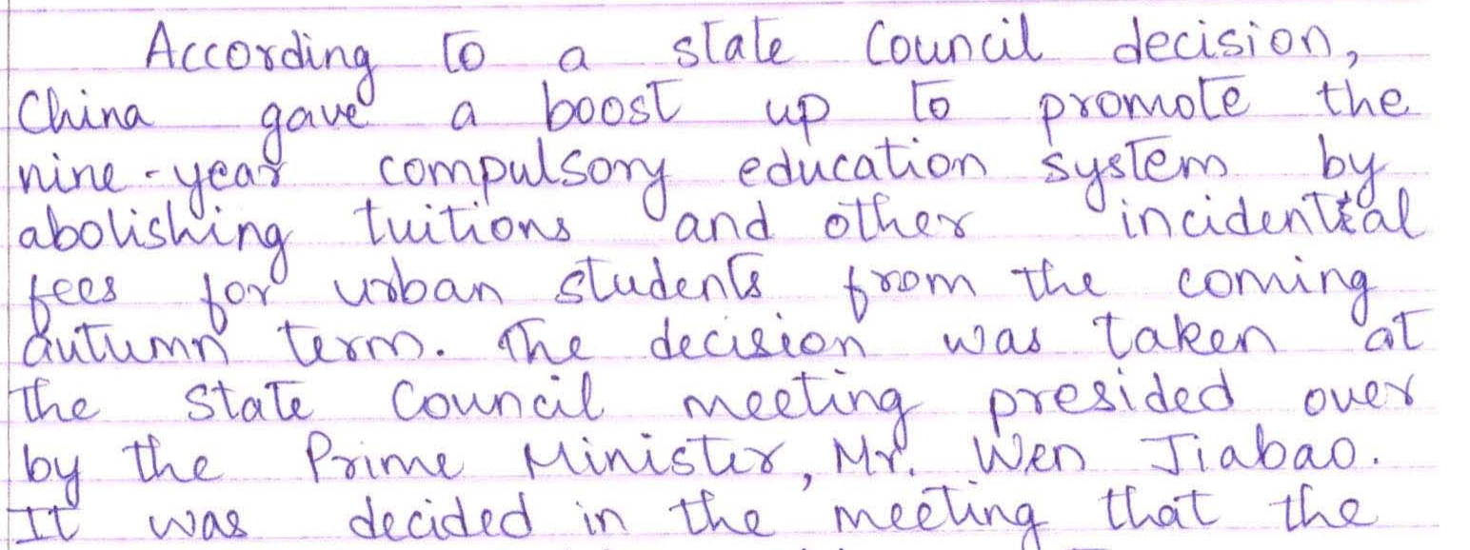
Coping with speech: an analogy
note: speechdoesnothavepauses (blanks) betweenwords
well articulated, standard (dialect free) speech; note: still lots of variation

Slide 8
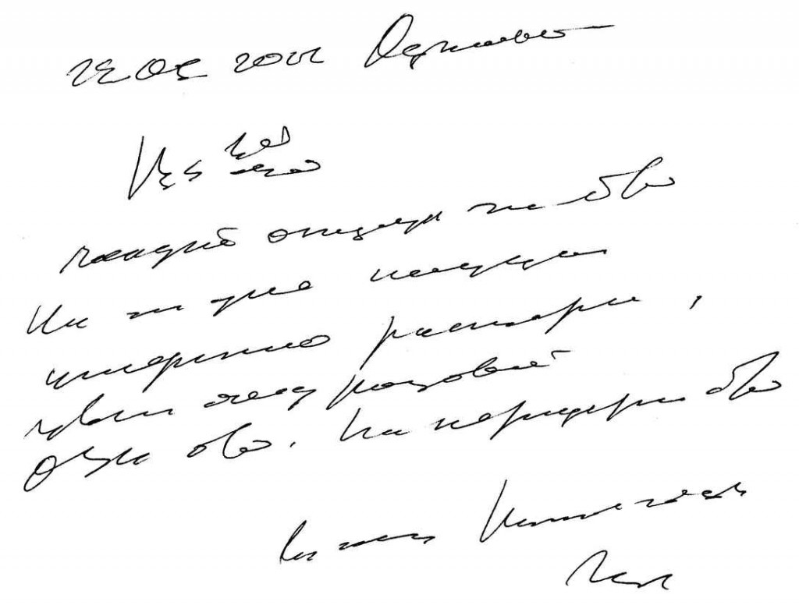
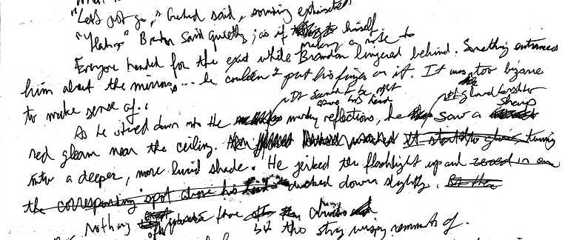

Coping with speech: an analogy
speech with heavy dialect
spontaneous speech
speech in noise

Slide 9
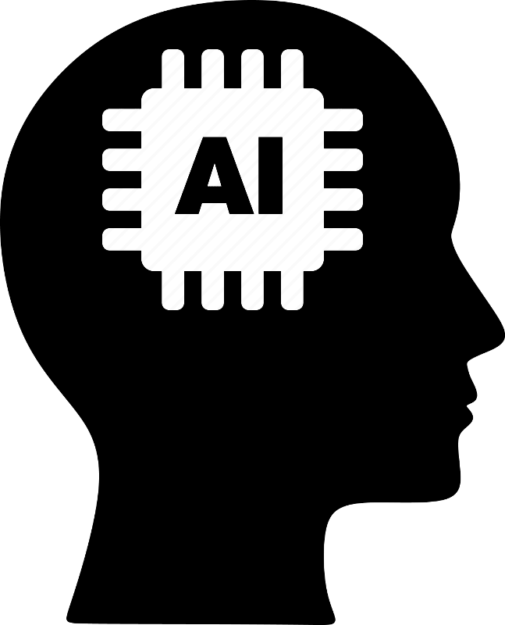
Speech & language by computer: AI
Artificial intelligence (AI):
techniques to learn computers to mimic human behaviour such as reasoning or speech understanding

Slide 10
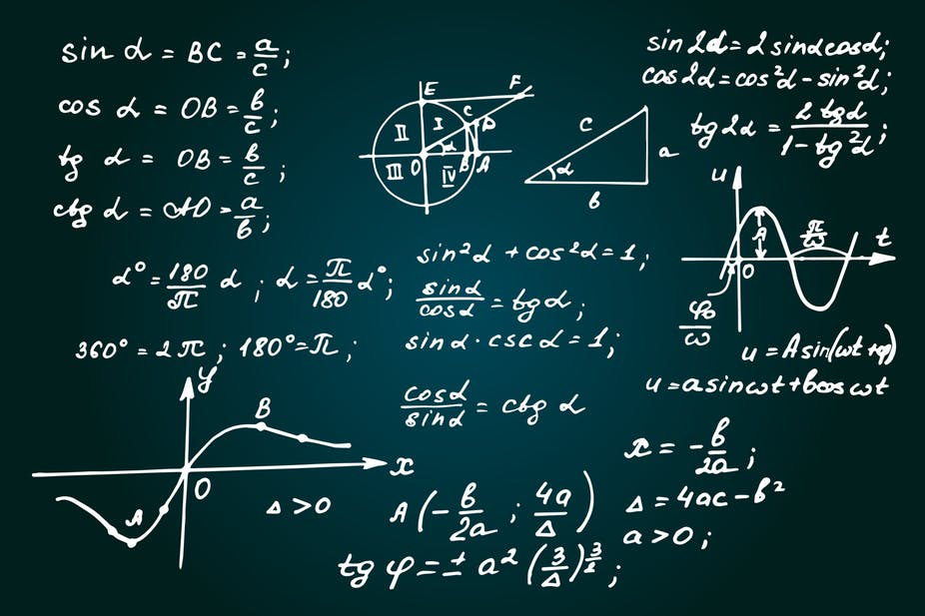
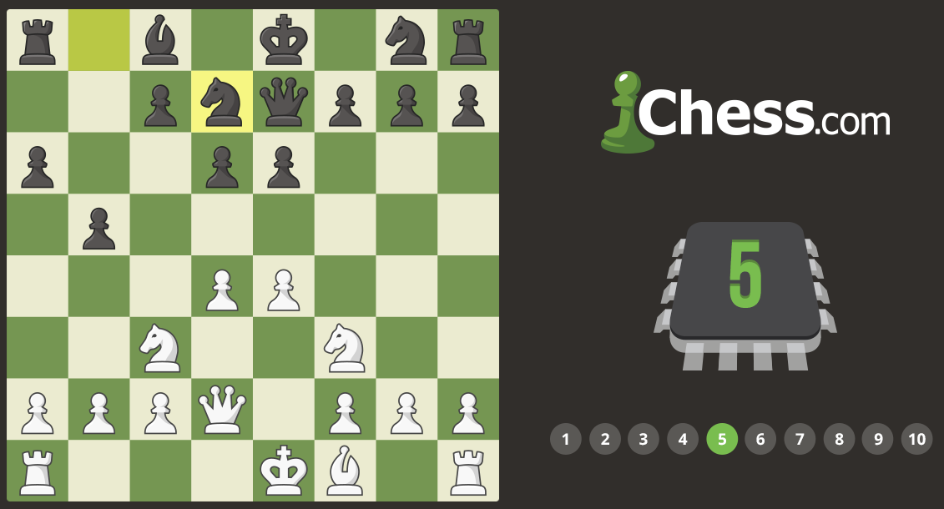
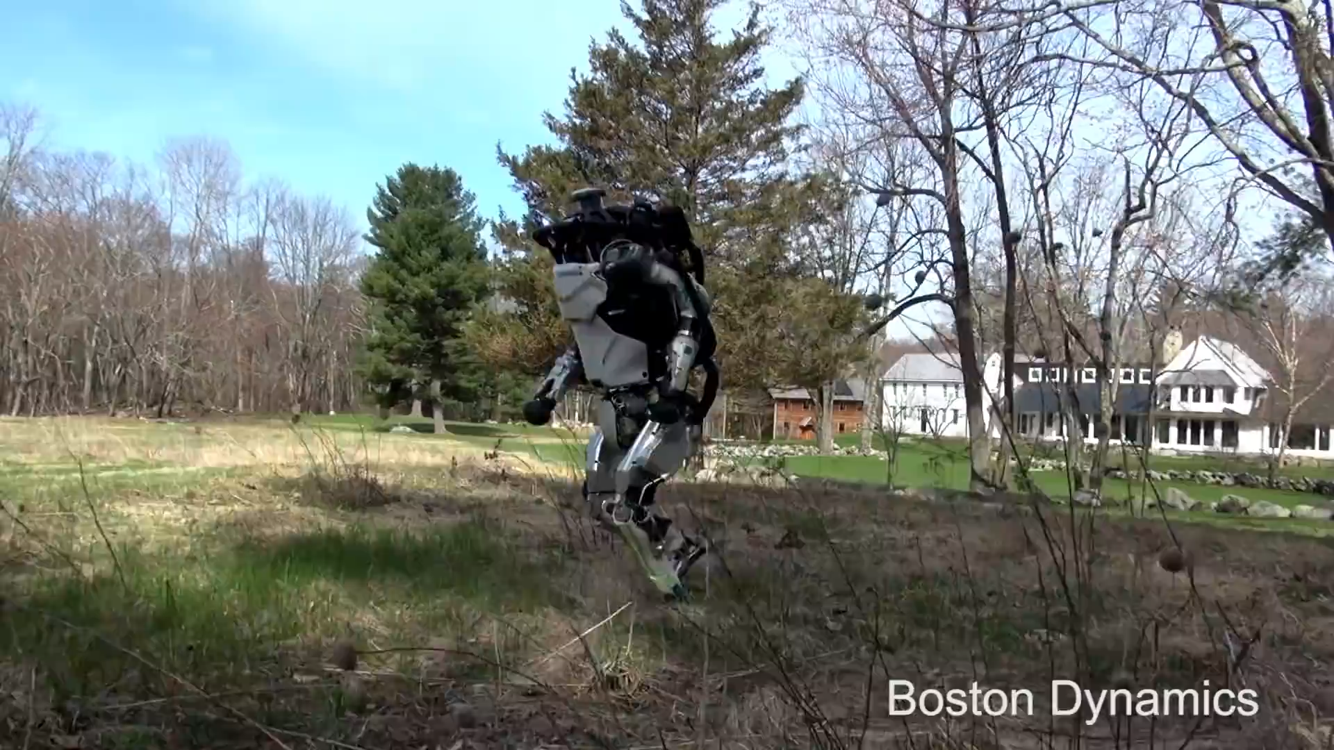
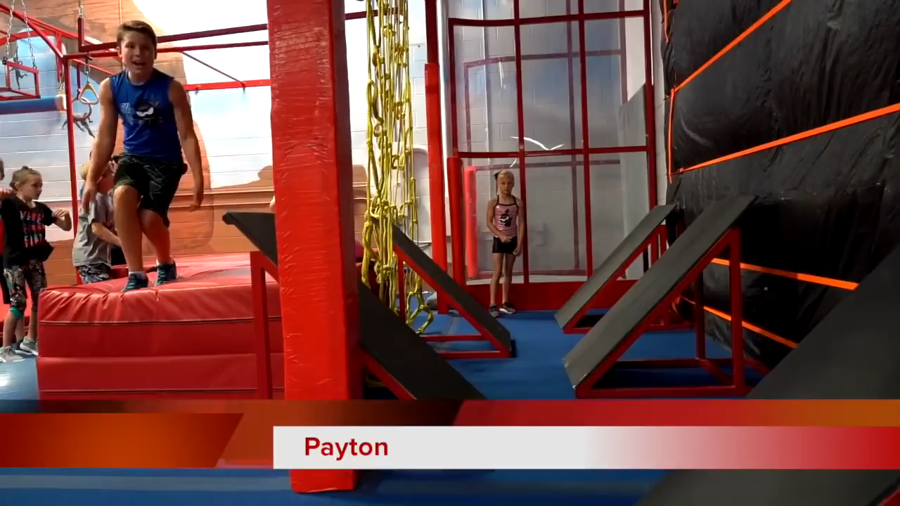
Artificial intelligence: Maravec’s paradigm
what is considered difficult for humans, tends to be easy for computers,
what seems easy to humans tends to be very challenging for computers
difficult for humans
difficult for computers

Slide 11
Artificial intelligence: Maravec’s paradigm
what is considered difficult for humans, tends to be easy for computers,
what seems easy to humans tends to be very challenging for computers
However, what seems easy to humans …
tends to be essential in life (survival of the fittest), …
… and hence, has been perfected over millions years of evolution
is practiced daily, …
.. and, did require a fair amount to learn

Slide 12
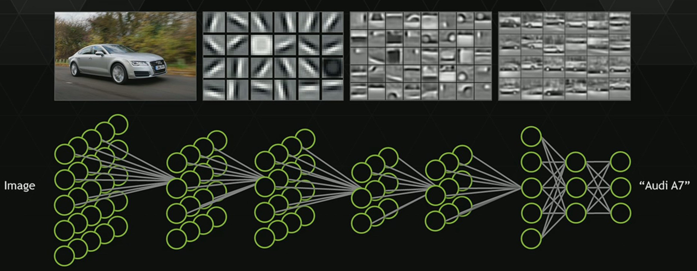

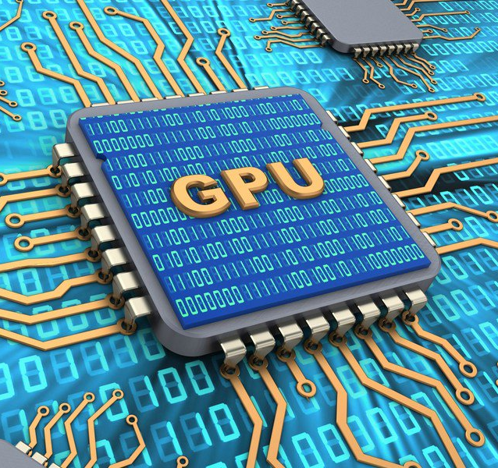

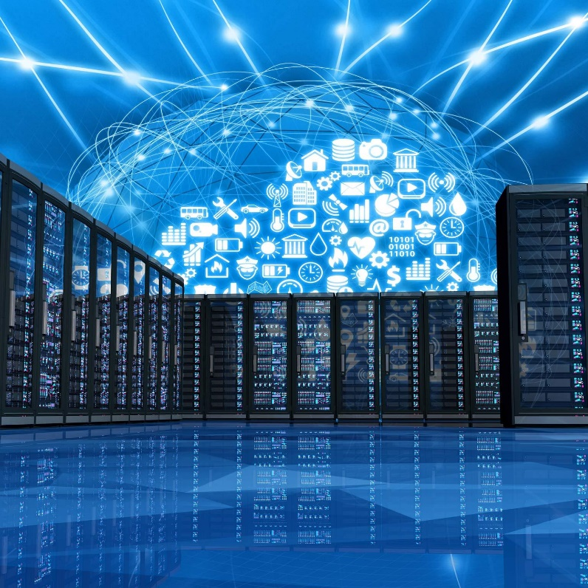
Deep learning & neural networks: what & why now?
What1: learn from data (examples)
What2: multiple layers
learns to decomposing the problem
in sub-problems
Why now1: compute power is now available,
thanks to 3D gaming (GPU)
Why now2: easy access to large amounts
of data thanks to the Internet

Slide 13
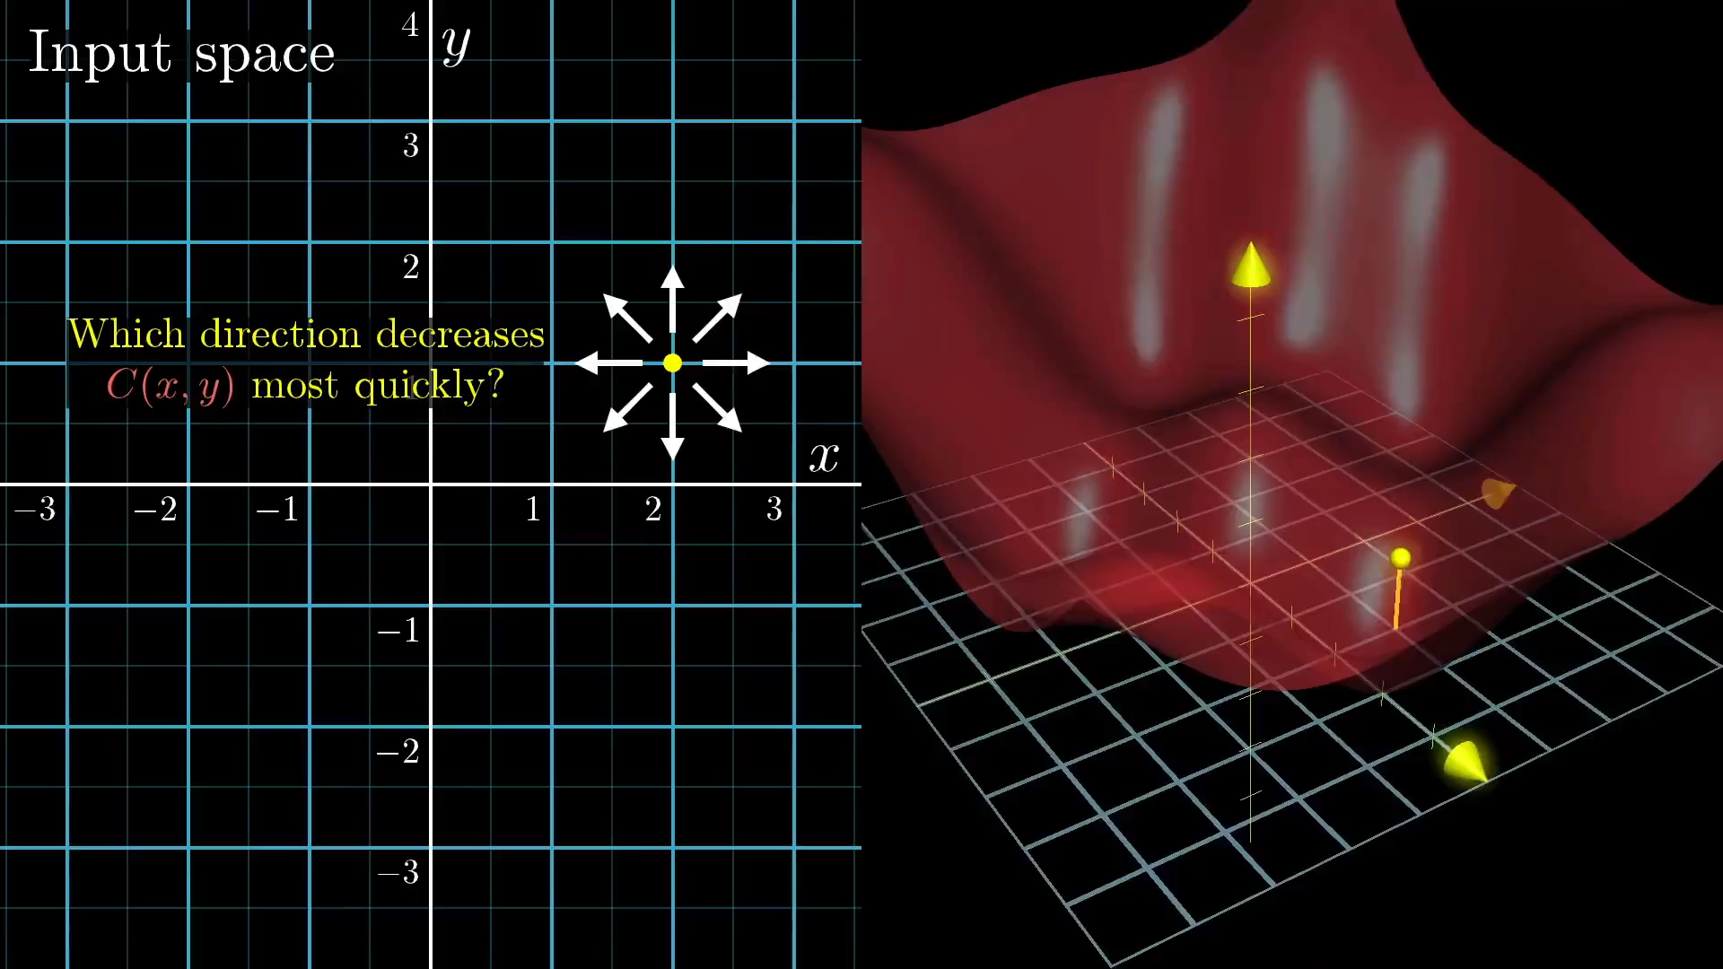
Deep learning & neural networks: how
define cost function → math: search minimum (derivatives, matrices)

Slide 14
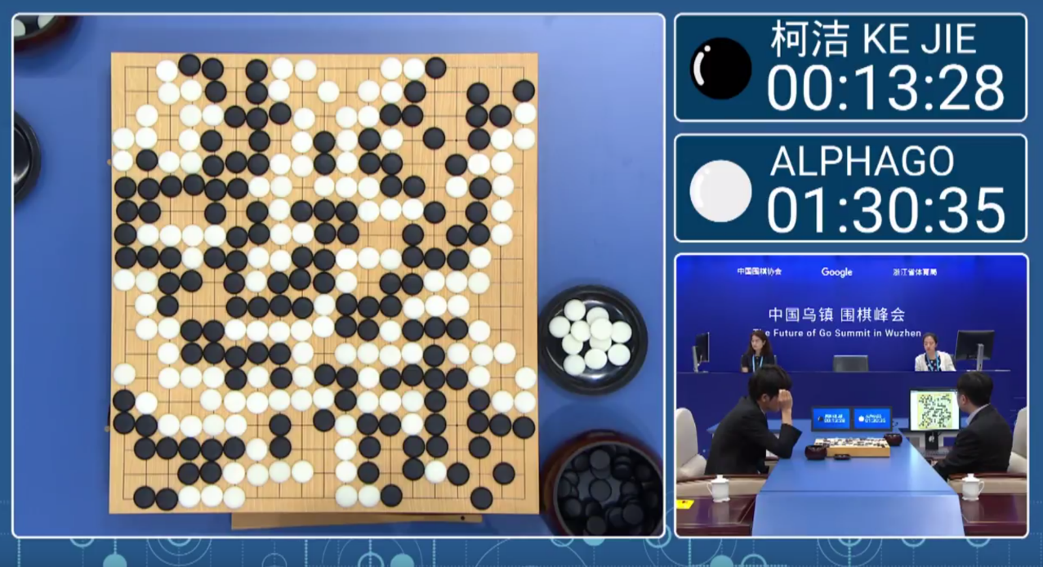
Deep learning & neural networks: cost function
straightforward for problems of the type
mimic this behaviour (reproduce)
often a challenge to put other problems in this straitjacket
no one knows the cost function for true intelligence (strong AI)

Slide 15
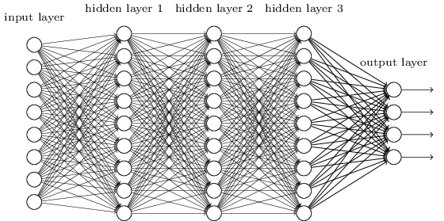
Speech → Text (S2T)
easy cost function:
main challenge: collecting 1000+ hours of annotated speech is costly
easy:
read speech: annotations are known (e.g. books on tape)
noisy speech: just add noise (lots of variation possible) to clean speech
difficult:
spontaneous speech, dialects, …
costly to annotate
correlate:
works better for large and rich language groups
lagging for smaller or poor language groups
problems with dialects, spontaneous speech, …

Slide 16
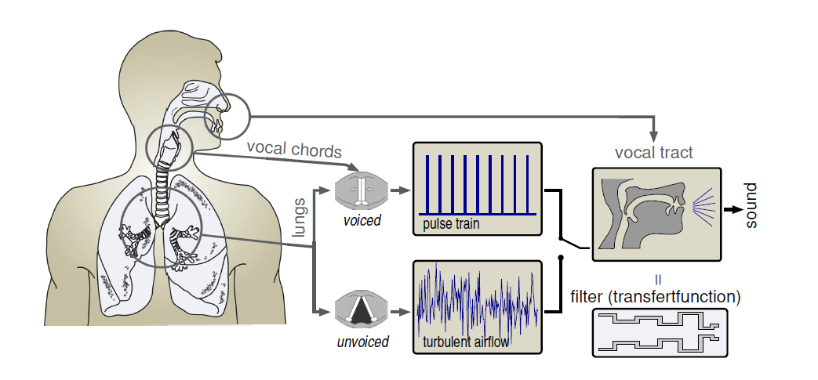
Text → Speech (TTS)
easy cost function:
(Very) old approach: “engineer” a voice
problem: sounds artificial
(no variation/emotions)
Modern approach:
learn from data
deep learning: split speaker characteristics (timbre, tempo, …) and sound generation
  localize speaker in a huge speaker space → easy to mimic a new speaker (Lyrebird)
is now a mature technology for most languages
remaining challenges: natural speech with emotions, singing, …
collecting and annotating example data is difficult and expensive
example: hire actors

Slide 17
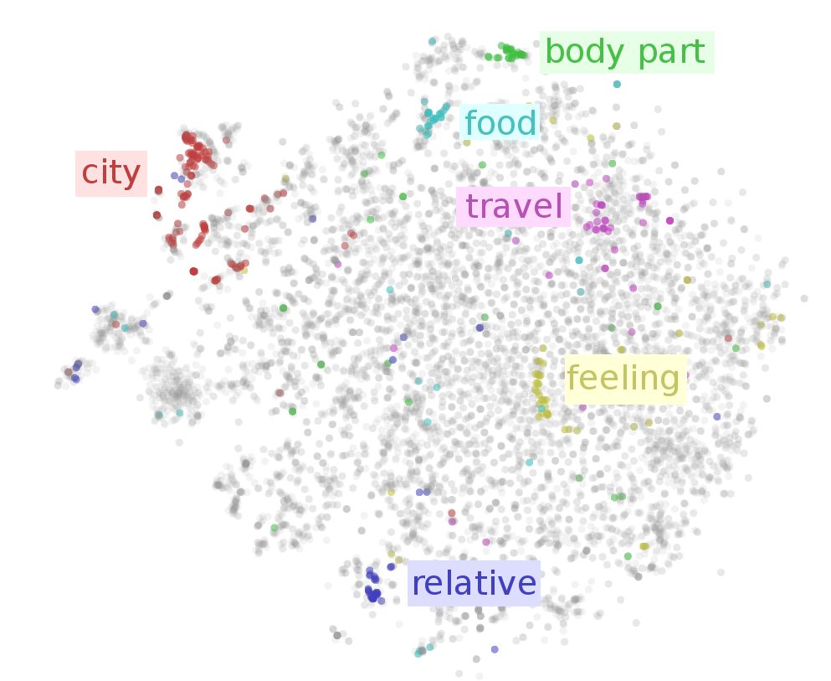
Understanding the meaning of words, … (NLP)
embeddings (same meaning → same location in a huge vector space)
distributional hypothesis (linguistics):
"a word is characterized by the company it keeps“ (Firth, 1950s)
step1: collect very large text corpora (easy for written text)
(billions of words, i.e. multiple life-times of speech+text material)
step2: cost function ― items (words, phrases, …) that
surrounded by the same words have a similar meaning
→ cost = distances in a high dim. vector space
work very good, even allows math on words:
king – man + woman ≈ queen
applying this to phrases, sentences, paragraphs, …:
→ multi-layered approach (transformers)
main challenge: spoken language ≠ written language
  translation form spoken to written is needed
  no (little) example data

Slide 18
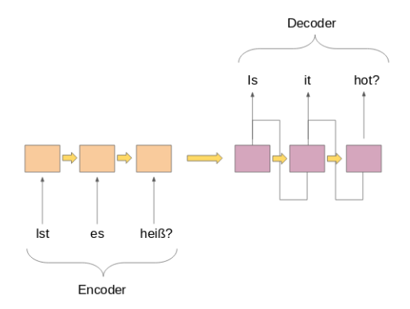
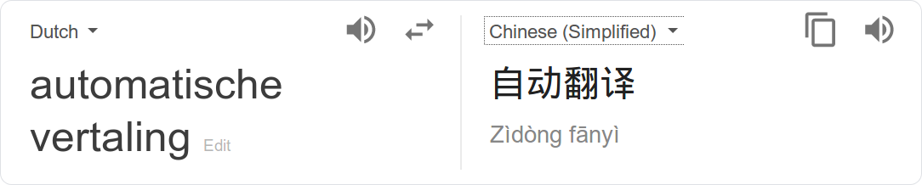
Translation: Text (L1) → Text (L2)
transform (encode → generate)

Slide 19
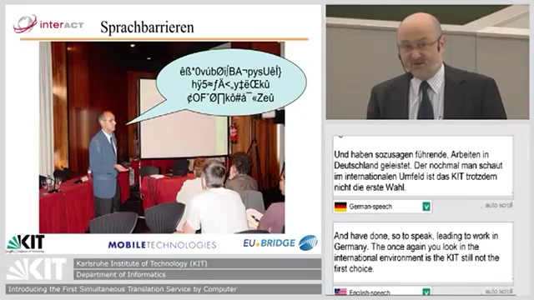
Speech (L1) → Speech (L2)
Computer: phased approach
detect sentence end
speech recognition
translate sentence
speech synthesis
Reason:
  handling complete sentences works better (in every step)
Human interpreter: anticipate what will be said
speaker matches anticipation → low delay translation
speaker deviates from anticipation → correction (cf. spontaneous speech)

Slide 20
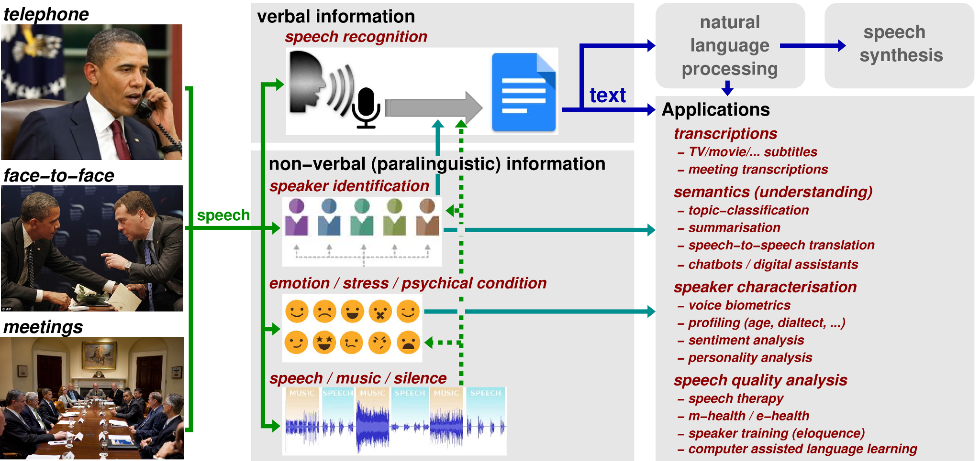
More speech & language applications

Slide 21

Conclusion (main take-away message)
speech and language are difficult
humans are, by nature, experts in language and speech
computers are not yet at the same level as humans
have realistic expectations

